Slide 1
Welcome to Thermo!
Let’s check out the syllabus on Canvas, especially
Resources you’ll need
Rhythm of the week
What CGIs are
Contingencies for missing class
Evaluation
Topic schedule

Slide 2
Why (and how) to learn Thermo?
A lot of Thermo is about making this connection:
Macroscopic world
Microscopic world
→ Use macroscopic experience (measurements of T, P, V, etc.) to figure out how molecules behave
Use what we think we know about how molecules behave to make predictions about the macroscopic world
The formal (mathematical) structure of thermodynamics helps us make these connections. Hijacked, actually: thermodynamics was invented before people knew about atoms and molecules.

Slide 3
Using macroscopic experience to build up mental representations of microscopic processes
Macroscopic experience:
If you let a gas expand, it tends to cool down
Room Temperature

Slide 4
Using macroscopic experience to build up mental representations of microscopic processes
Macroscopic experience:
If you let a gas expand, it tends to cool down
Colder

Slide 5
Using macroscopic experience to build up mental representations of microscopic processes
Macroscopic experience:
If you let a gas expand, it tends to cool down
Colder still

Slide 6
Using macroscopic experience to build up mental representations of microscopic processes
Macroscopic experience:
If you compress a gas, it tends to heat up
Room Temperature

Slide 7
Using macroscopic experience to build up mental representations of microscopic processes
Macroscopic experience:
If you compress a gas, it tends to heat up
Warmer

Slide 8
Using macroscopic experience to build up mental representations of microscopic processes
Macroscopic experience:
If you compress a gas, it tends to heat up
Warmer still

Slide 9
The kinetic-molecular theory of gases
Normally, when a molecule hits a wall, it bounces back with the same speed.
Mental representation of a gas: molecules in constant motion

Slide 10
The kinetic-molecular theory of gases
Normally, when a molecule hits a wall, it bounces back with the same speed.
But when it hits a receding wall, it bounces back more slowly.
Slower-moving molecules correspond to lower temperature.
Mental representation of a gas: molecules in constant motion

Slide 11
Thermodynamic surfaces
What we’re showing here is a thermodynamic surface, also known as a state function. Its name here is F, but it could be P, U, H, S, or G.
The (x,y) space below is called the state space. Could be lots of different combinations, but typically it’ll be (T,V) or (T,P).
Obviously, there’s a particular value of F for each combination of x & y, so we say F = F(x,y)
State function F
y
“State Space”
x

Slide 12
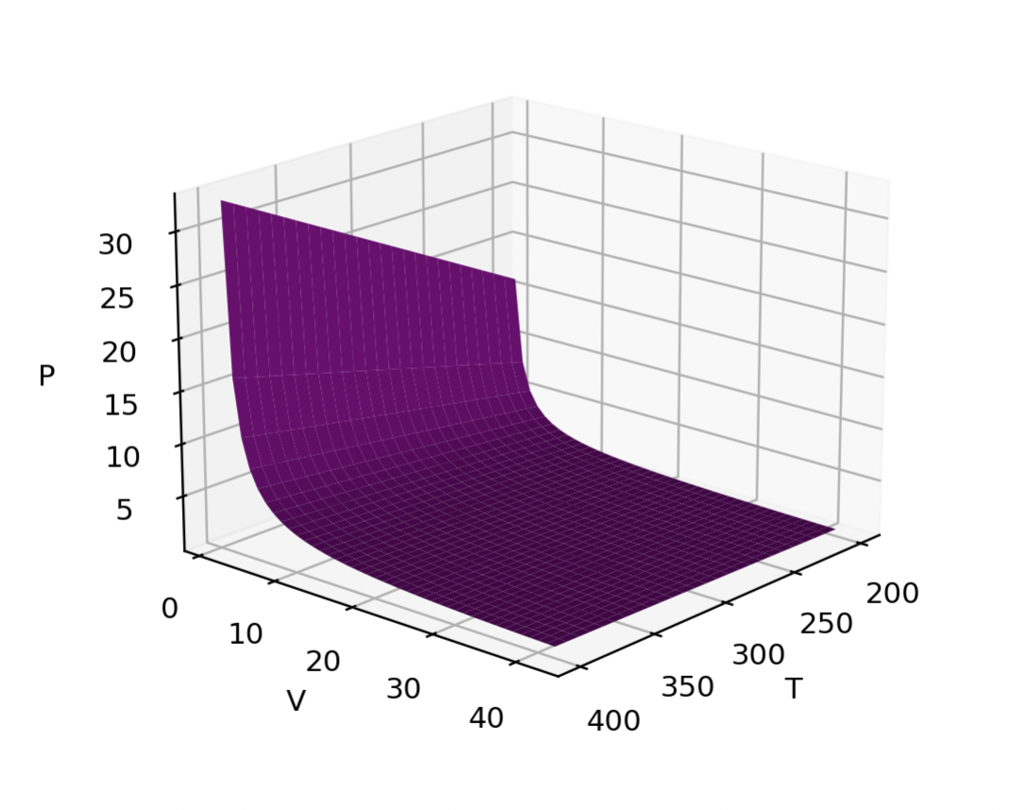
Thermodynamic surfaces
Here, the state function is the pressure of a gas.
The state space consists of the gas’s temperature and volume.
Each combination of temperature and pressure implies a particular value of the pressure:
P(T,V)
This one is an ideal gas, actually. So we can say
P(T,V)=nRT/V

Slide 13
Isotherms are slices through a thermodynamic surface
This marks a constant-temperature slice (“isotherm”) through P(T,V). In this case, the isotherm temperature is 350 K.

Slide 14
Isotherms are slices through a thermodynamic surface
This marks a constant-temperature slice (“isotherm”) through P(T,V). In this case, the isotherm temperature is 350 K.
This isotherm is colder, at 300 K.

Slide 15
Isotherms are slices through a thermodynamic surface
This marks a constant-temperature slice (“isotherm”) through P(T,V). In this case, the isotherm temperature is 350 K.
This isotherm is colder, at 300 K.
The word isotherm applies to any thermodynamic function, but when we’re talking P(T,V), the isotherms are called Boyle isotherms. So here is a hot Boyle isotherm and a cold Boyle isotherm.

Slide 16
What we did today …
Course mechanics
How the kinetic-molecular picture of gases helps us understand why gases cool on expansion and heat up on compression
Got an introduction to some key thermodynamic concepts: thermodynamic surfaces, state functions, state spaces, isotherms, and the meaning of notations like P(T,V)

